Slide 2
Course Overview
Day 1: Introduction to ML, Model Building, Text Processing, Bag of Words (BoW), and K Nearest Neighbors Model (KNN)
Day 2: Tree-based Models, Regression Models, Optimization, Regularization, Hyperparameter Tuning, AWS AI/ML Services
Day 3: Neural Networks, Word Embeddings, Recurrent Neural Networks (RNN), and Transformers
Day 4: Tabular Data, AutoGluon, Image Classification, Convolutional Neural Networks (CNN), and Transfer Learning

Slide 3
Topics for Day 3
Neural Networks (NN)
Word Embeddings
Recurrent Neural Networks (RNN)
Long Short-Term Memory (LSTM)
Transformers
Final Project

Slide 4
Topics for Day 3
Neural Networks (NN)
Word Embeddings
Recurrent Neural Networks (RNN)
Long Short-Term Memory (LSTM)
Transformers
Final Project

Slide 5
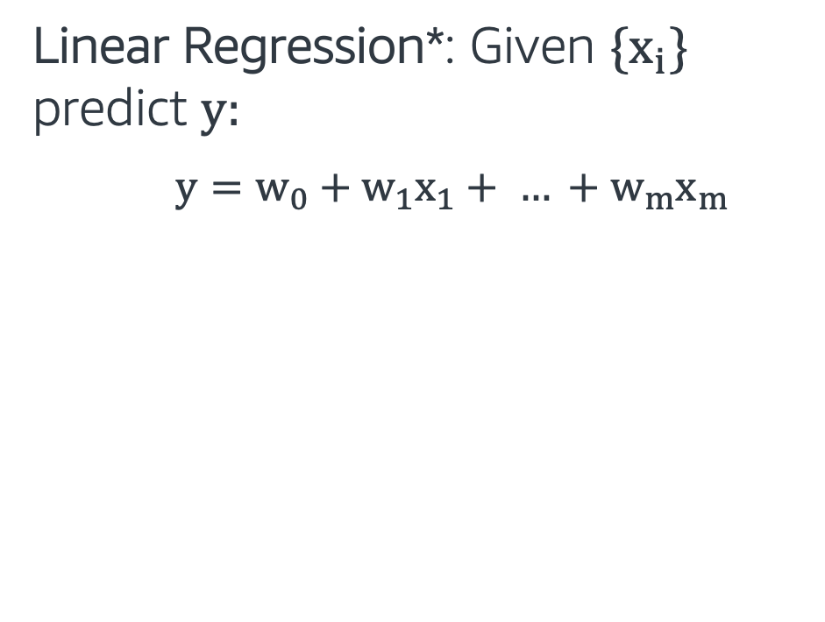
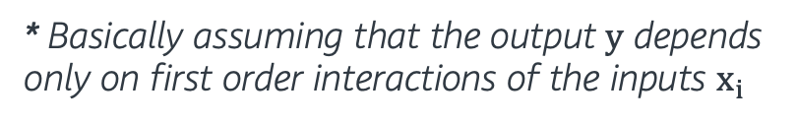

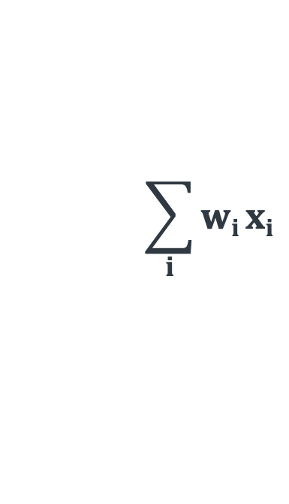
Looking back at Regression Models
Linear Regression*: Given {$x_{i}$} predict $y$:
$y=w_{0}+w_{1}x_{1}+ … +w_{m}x_{m}$
w₀
w₁ x₁
x₁
$$\sum_{i}{wi}xi$$
w₂ x₂
$$y$$
x₂
w₃ x₃
x₃
Input
Output
* Basically assuming that the output y depends only on first order interactions of the inputs $x_{i}$

Slide 6
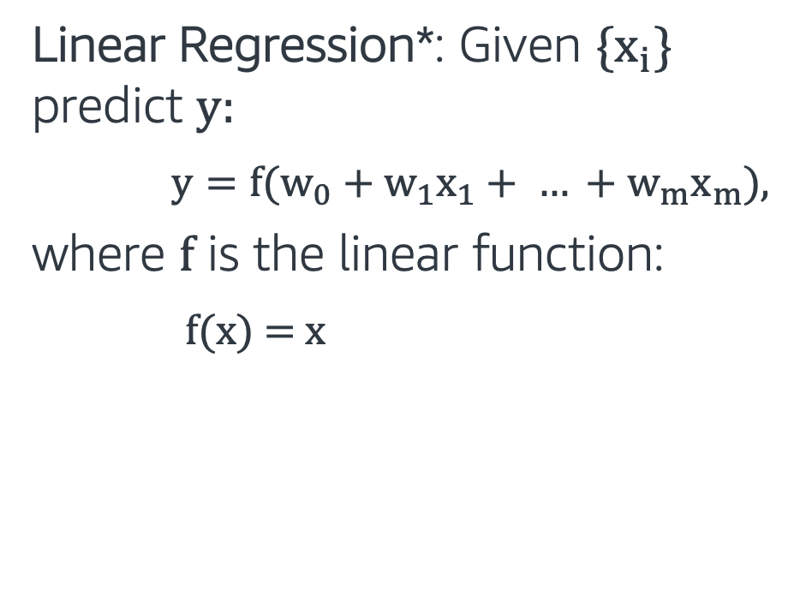
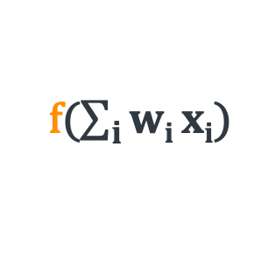
Looking back at Regression Models
Linear Regression*: Given {$x_{i}$} predict $y:$
$y={f(w}_{0}+w_{1}x_{1}+ … +w_{m}x_{m}$),
where f is the linear function:
$f$(x) = x
w₀
w₁ x₁
x₁
$$\sum_{i}{wi}xi$$
f($\sum_{i}{wi}xi$)
w₂ x₂
f
$$y$$
x₂
w₃ x₃
x₃
Input
Activation
function
Output
* Basically assuming that the output y depends only on first order interactions of the inputs $x_{i}$

Slide 7
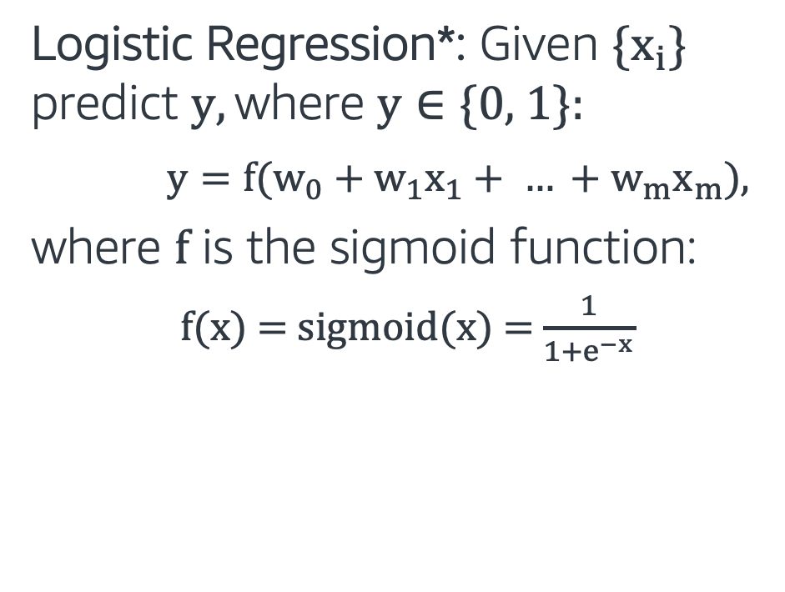
Looking back at Regression Models
Logistic Regression*: Given {$x_{i}$} predict $y, \text{where} \text{y}∈\text{\{0, 1\}}$:
$y={f(w}_{0}+w_{1}x_{1}+ … +w_{m}x_{m}$),
where f is the sigmoid function:
$f$(x) = $sigmoid$(x) = $\frac{1}{1+e^{−x}}$
w₀
w₁ x₁
x₁
$$\sum_{i}{wi}xi$$
f($\sum_{i}{wi}xi$)
w₂ x₂
f
$$y$$
x₂
w₃ x₃
x₃
Input
Activation
function
Output
* Non-linear activation function

Slide 8
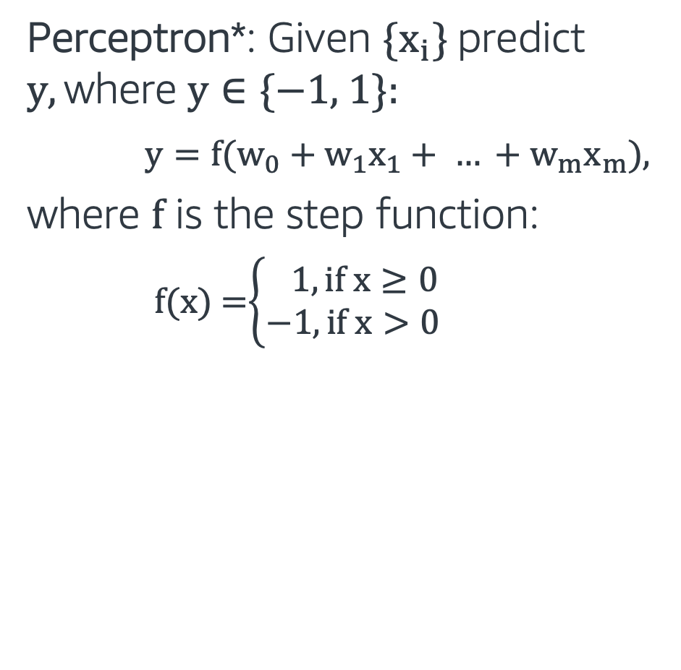
Perceptron
Perceptron*: Given {$x_{i}$} predict $y, \text{where} \text{y}∈\text{\{−1, 1\}}$:
$y={f(w}_{0}+w_{1}x_{1}+ … +w_{m}x_{m}$),
where f is the step function:
$f$(x) =$\left\{\begin{aligned} 1, if x≥0 \\ −1, if x>0\end{aligned}\right.$
w₀
w₁ x₁
x₁
$$\sum_{i}{wi}xi$$
f($\sum_{i}{wi}xi$)
w₂ x₂
f
$$y$$
x₂
w₃ x₃
x₃
Input
Activation
function
Output
* Another non-linear activation function

Slide 9
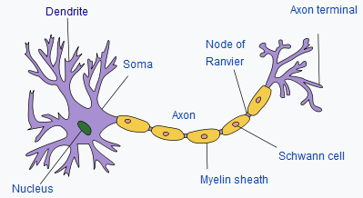
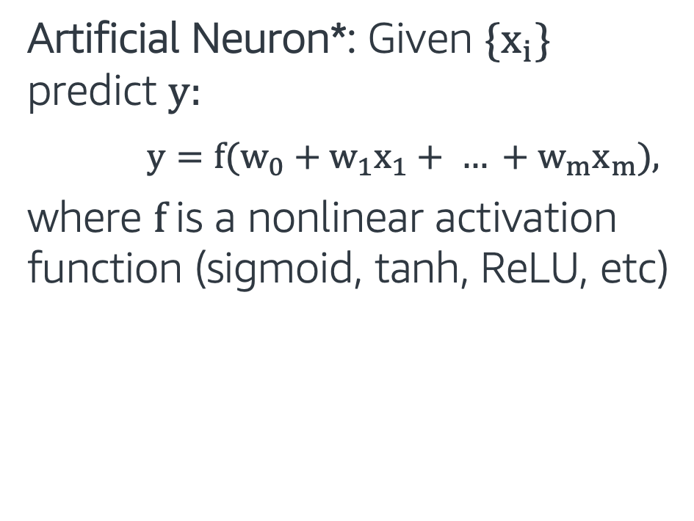
Artificial Neuron
Artificial Neuron*: Given {$x_{i}$} predict $y$:
$y={f(w}_{0}+w_{1}x_{1}+ … +w_{m}x_{m}$),
where f is a nonlinear activation function (sigmoid, tanh, ReLU, etc)
w₀
w₁ x₁
x₁
$$\sum_{i}{wi}xi$$
f($\sum_{i}{wi}xi$)
w₂ x₂
f
$$y$$
x₂
w₃ x₃
x₃
Input
Activation
function
Output
* Similar to how neurons in the brain function

Slide 10
Artificial Neuron
Artificial Neuron: Captures mostly linear interactions in the data
Question: Can we use a similar approach to capture non-linear interactions in the data?
w₀
w₁ x₁
x₁
$$\sum_{i}{wi}xi$$
f($\sum_{i}{wi}xi$)
w₂ x₂
f
$$y$$
x₂
w₃ x₃
x₃
Input
Activation
function
Output

Slide 11
Multi Layer Perceptron
Artificial Neuron: Captures mostly linear interactions in the data
Question: Can we use a similar approach to capture non-linear interactions in the data?
Neural Network/Multilayer Perceptron: Use more Artificial Neurons, stack in layers!
input layer
hidden layer 1
hidden layer 2
output layer

Slide 12
Multi Layer Perceptron
A neural network consisting of input, hidden and output layers.
Each layer is connected to the next layer.
Except for the input units, each neuron has an activation function.
input layer
hidden layer 1
hidden layer 2
output layer

Slide 13
Why Neural Networks?
In the last 5-10 years, neural networks achieved state-of-the art results in many different machine learning areas.
Neural networks can automatically extract useful features from input data. Traditionally feature engineering has been the most laborious and unprincipled part of building ML models
When using neural networks, we should be careful about model complexity and make sure we have enough amount of data for training.

Slide 14
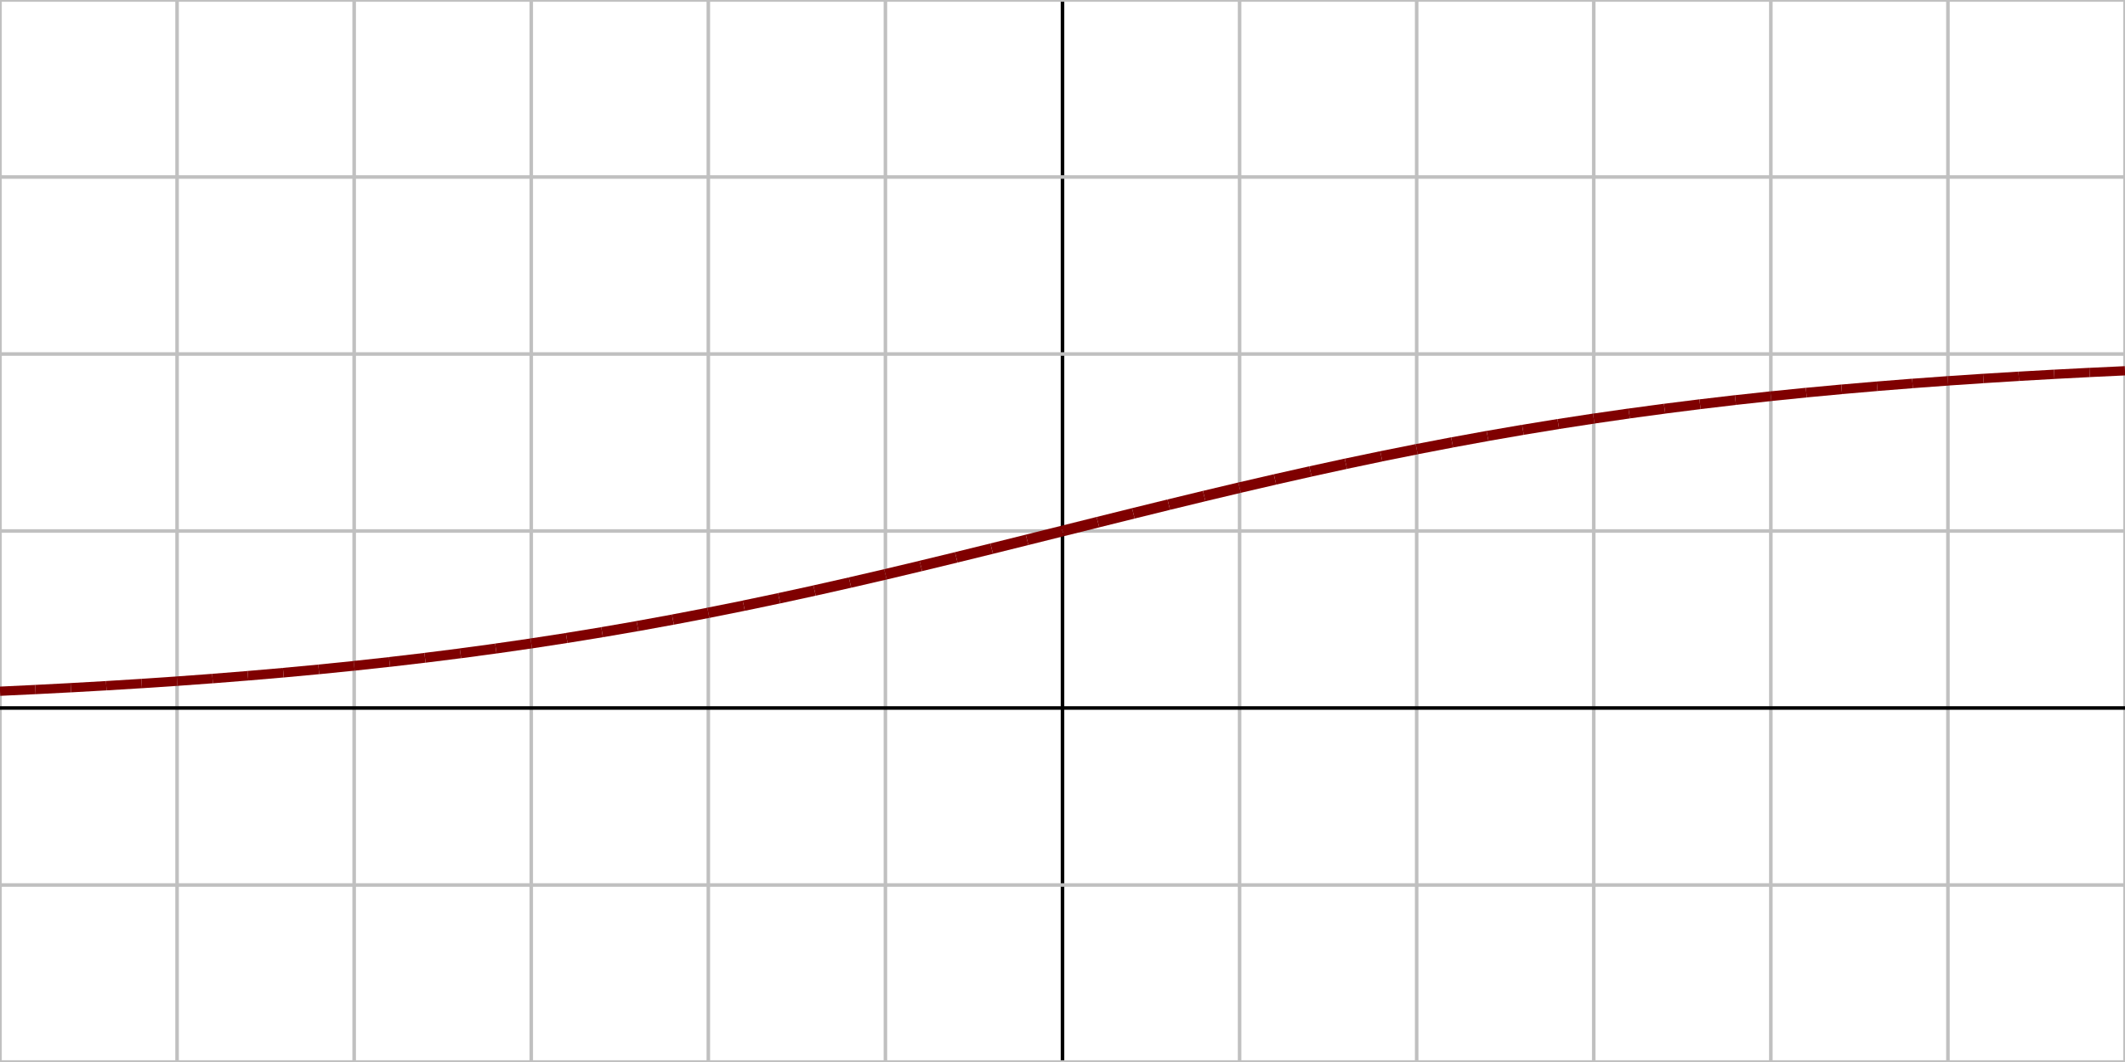
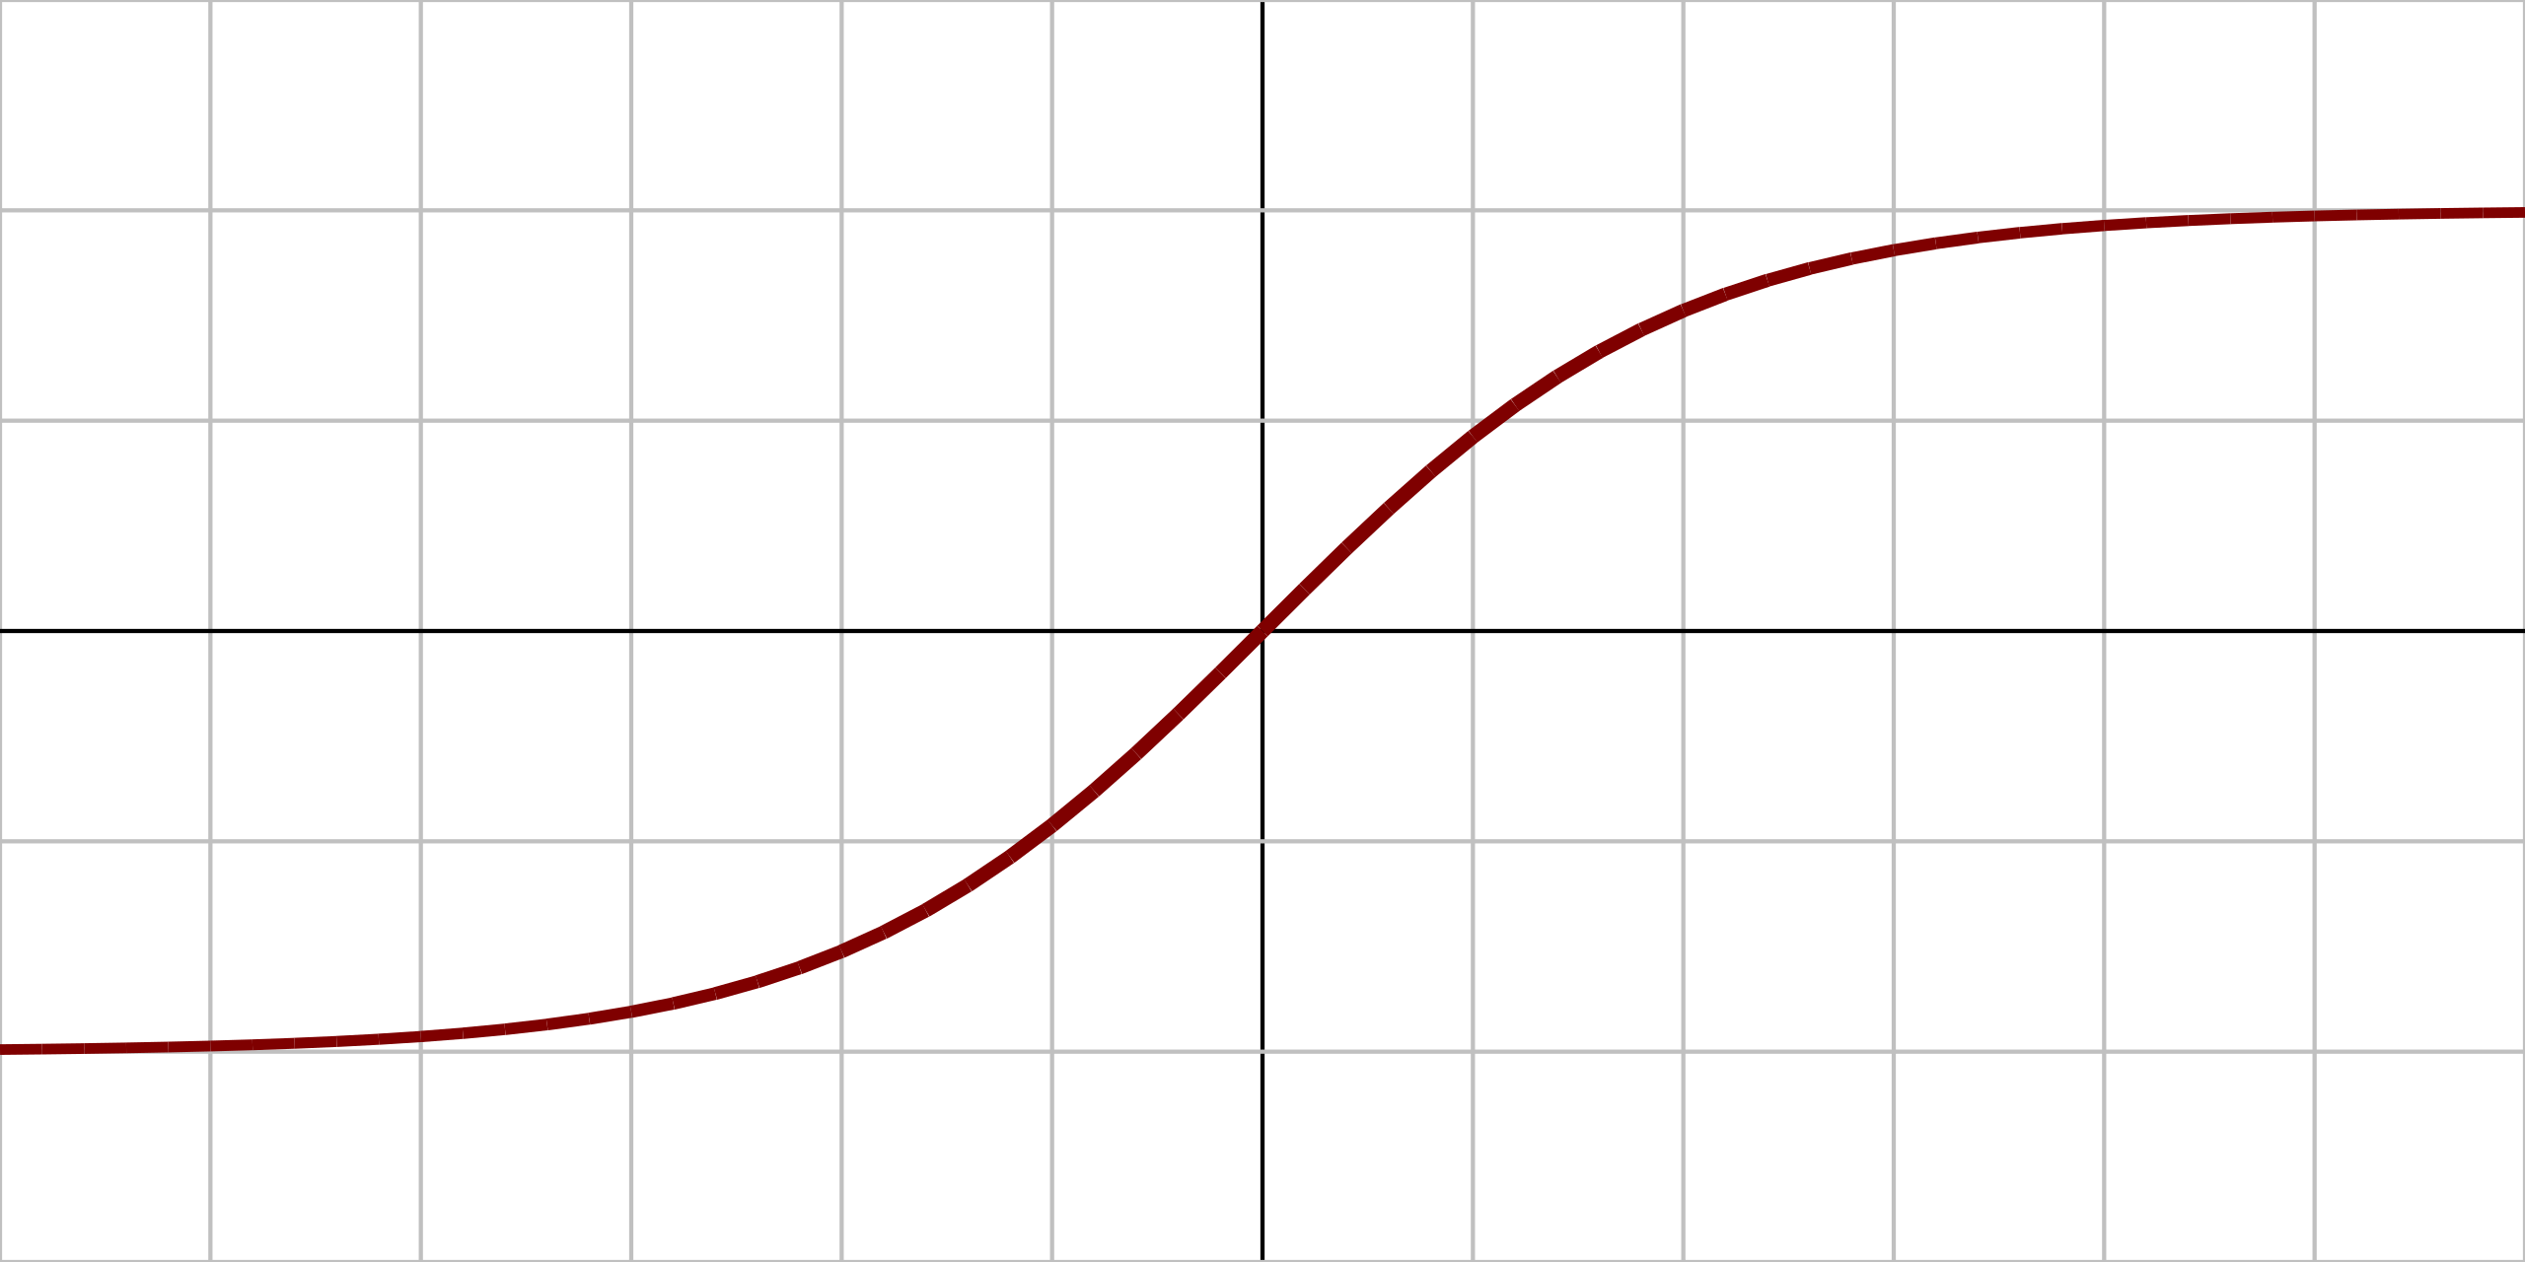
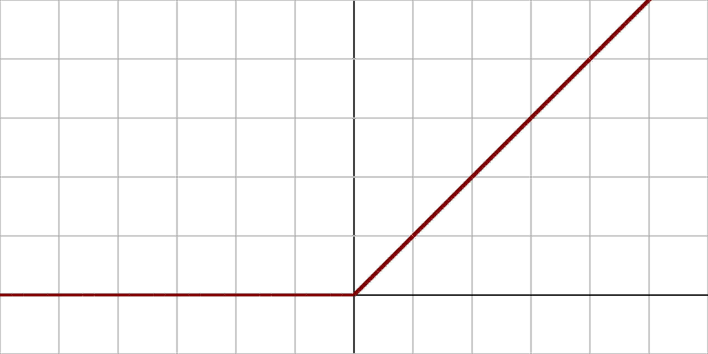
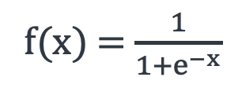
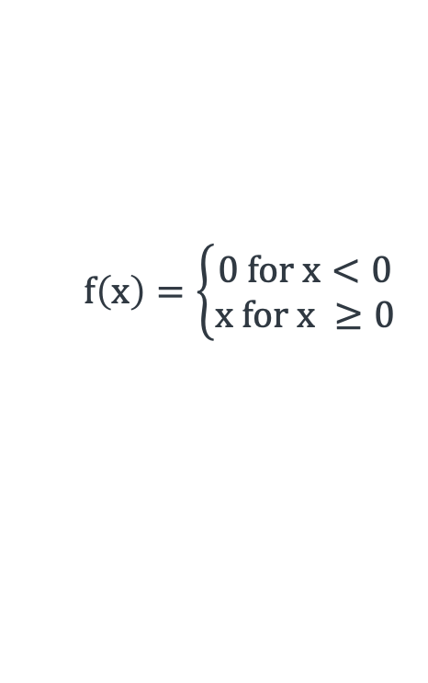
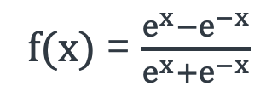
Activation Functions
Derivatives of these functions are also important when we use gradient descent.
Name | Plot | Function | Description
Logistic (sigmoid) |  |  | The most common activation function. Squashes input to (0,1)
Hyperbolic tangent (tanh) |  |  | Squashes input to (-1, 1)
Rectified Linear Unit (ReLU) |  |  | Popular activation function. Anything less than 0, results in zero activation
1
f(x) = $\frac{1}{1+e^{−x}}$
0
x
1
f(x) = $\frac{e^{x}−e^{−x}}{e^{x}+e^{−x}}$
0
-1
x
$$f\left(x\right)=\left\{\begin{aligned}0 for x<0 \\ x for x ≥0\end{aligned}\right.$$
0
x

Slide 15
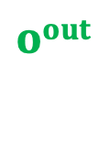
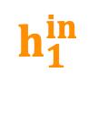

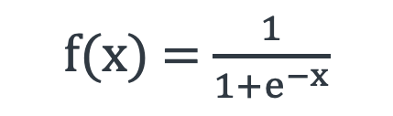
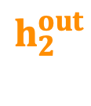

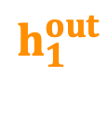
Forward Pass
Assume we have a network with:
2 inputs: i₁ = 0.5 and i₂ = 0.1
1 output (Binary classification: 0 or 1)
1 Hidden layer with 2 neurons
All neurons have sigmoid activation function:
i₁
w₁
$$h_{1}^{in}$$
$$h_{1}^{out}$$
w₅
w₃
w₂
$$oin$$
$$oout$$
i₂
w₄
$$h_{2}^{in}$$
$$h_{2}^{out}$$
w₆
f(x) = $\frac{1}{1+e^{−x}}$

Slide 16
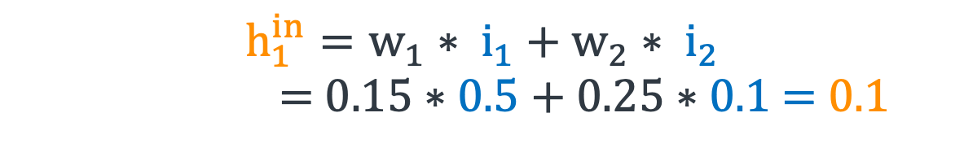
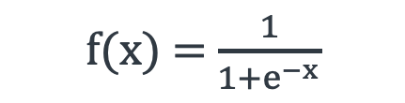
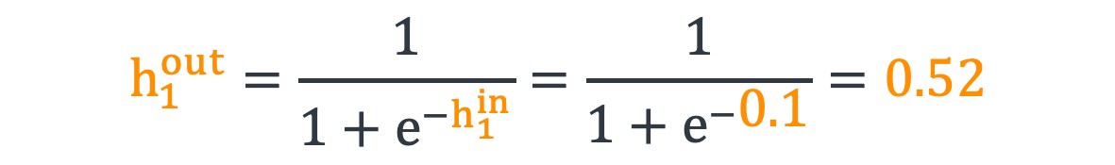
Forward Pass
If w₁ = 0.15, w₂ = 0.25, w₃ = 0.2, w₄ = 0.3, w₅ = 0.4, and w₆ = 0.45:
0.15
$$h_{1}^{in}$$
$$h_{1}^{out}$$
$$h_{1}^{in}=w_{1}∗ i_{1}+w_{2}∗ i_{2}$$
= $0.15∗0.5+0.25∗0.1$ = 0.1
0.5
0.2
0.4
0.25
$$oin$$
$$oout$$
0.1
0.3
$$h_{2}^{in}$$
$$h_{2}^{out}$$
$$h_{1}^{out}=\frac{1}{1+e^{−h_{1}^{in}}}=\frac{1}{1+e^{−\text{0}\text{.1}}}=0.52$$
0.45
Similarly,
f(x) = $\frac{1}{1+e^{−x}}$
$$h_{2}^{out}=0.53$$

Slide 17
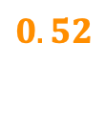
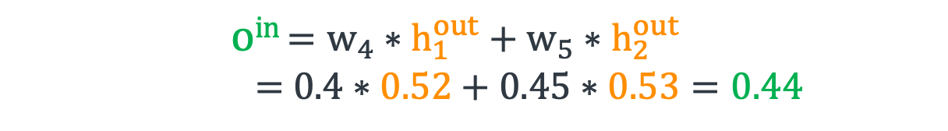
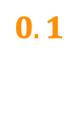
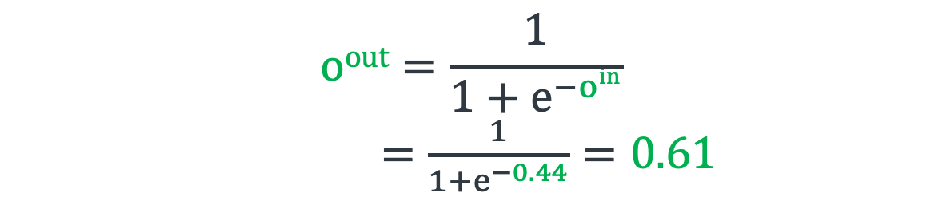
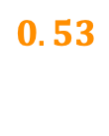
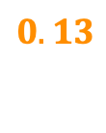
Forward Pass
If w₁ = 0.15, w₂ = 0.25, w₃ = 0.2, w₄ = 0.3, w₅ = 0.4, and w₆ = 0.45:
0.15
$oin$ $=w_{4}∗h_{1}^{out}+w_{5}∗h_{2}^{out}$
= $0.4∗0.52+0.45∗0.53=0.44$
0.5
$$0.1$$
$$0.52$$
0.2
0.4
0.25
$$oin$$
$$oout$$
$$oout=\frac{1}{1+e^{−oin}}$$
$=\frac{1}{1+e^{−0.44}}=0.61$
0.1
0.3
$$0.13$$
$$0.53$$
0.45
For binary classification, we would classify this as class 1 (as 0.61 > 0.5)

Slide 18
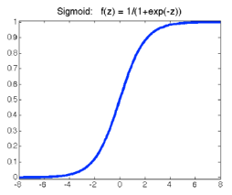
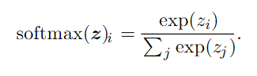

Output Function
Binary classification: Sigmoid
Outputs P(target class | x) in (0,1)
Last layer is Logistic Regression of output of previous layers
Multi-class classification: Softmax
Still want probability for each class output in (0,1)
Want sum of output to be 1 (probability distribution)
Training drives value for target class up, others down
Regression: Output activation can be linear or ReLU
f(x) = $\frac{1}{1+e^{−x}}$

Slide 19
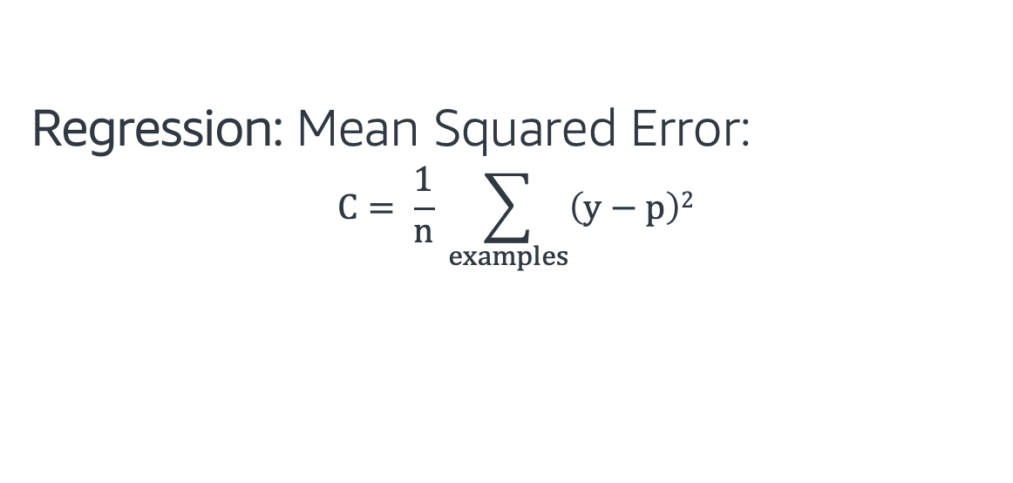
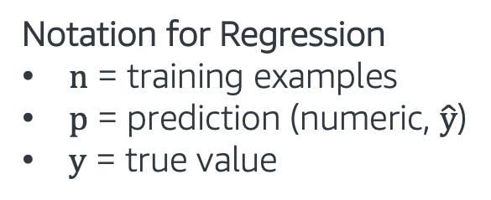
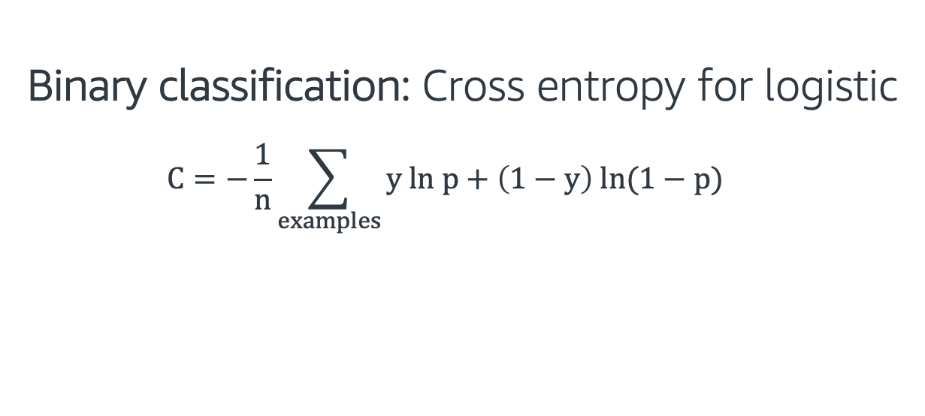
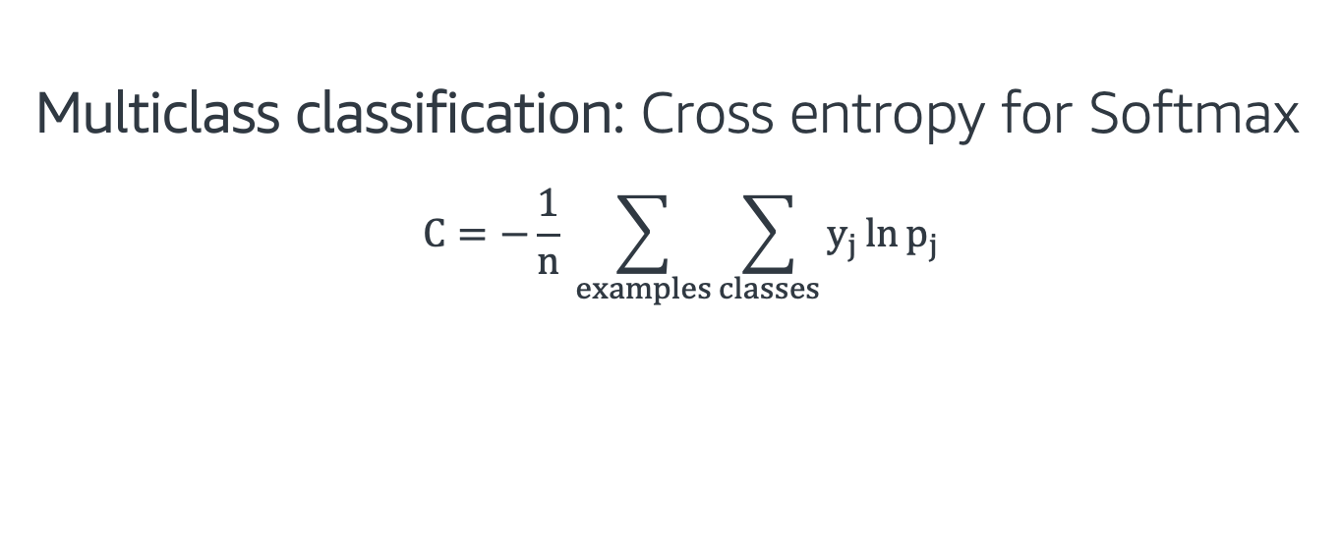
Cost Functions
Binary classification: Cross entropy for logistic
$$C=−\frac{1}{n}\sum_{examples}{y ln p+\left(1−y\right) ln(1−p)}$$
Notation for Classification
n = training examples
j = classes
p = prediction (probability)
y = true class (1/yes, 0/no)
Multiclass classification: Cross entropy for Softmax
$$C=−\frac{1}{n} \sum_{examples}{\sum_{classes}{y_{j}\ln{p_{j}}}}$$
Regression: Mean Squared Error:
$$C= \frac{1}{n} \sum_{examples}{\left(y−p\right)2}$$
Notation for Regression
n = training examples
p = prediction (numeric, $\hat{y}$)
y = true value

Slide 20
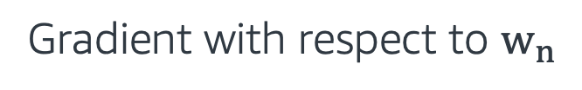
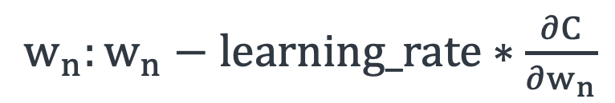
Training Neural Networks
During the training of neural networks, we update the weights in the network by applying the gradient descent method.
Cost function is selected according to problem: Binary, Multi-class Classification or Regression.
Weight update formula:
$w_{n}:w_{n}−learning_rate∗\frac{∂C}{∂w_{n}}$
C: Cost
Gradient with respect to $w_{n}$

Slide 21
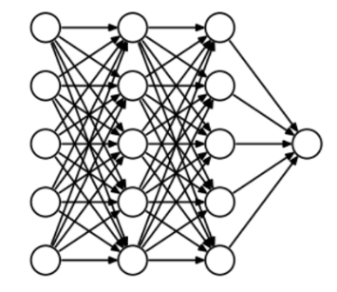
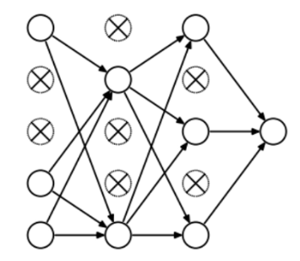
Dropout
Regularization technique to prevent overfitting.
Randomly removes some nodes and their connections during the training.

Slide 22

Neural Networks - Hands on
In this exercise, we implement neural networks using the Gluon Library.
Gluon is an open source deep learning library.
The exercise covers the following topics:
Sequential module
Loss functions
Trainer module
Follow through this notebook: “EMBK-NLP-DAY3-NN-NB.ipynb”

Slide 23
Topics for Day 3
Neural Networks (NN)
Word Embeddings
Recurrent Neural Networks (RNN)
Long Short-Term Memory (LSTM)
Transformers
Final Project

Slide 24
Word Representations
One-hot-encoding: We can represent each word in a vocabulary with one-hot codes.
Example: Assume a vocabulary V of size 10,000
V = [<UNKN>, a, about, …, zombie] (<UNKN> is reserved for unknown words)
Word | Code
<UNKN> | [1, 0, 0, …., 0]
a | [0, 1, 0, …., 0]
about | [0, 0, 1, …., 0]
.. | ..
.. | ..
zombie | [0, 0, 0, …., 1]

Slide 25
Word Representations
Let’s look at the following words and their codes:
man | woman | king | queen | lemon | apple
0 | 0 | 0 | 0 | 0 | 0
0 | 0 | .. | .. | 0 | 1
0 | .. | .. | .. | .. | ..
.. | .. | .. | .. | .. | ..
.. | .. | 1 | .. | .. | ..
.. | .. | .. | .. | 1 | ..
1 | .. | .. | .. | .. | ..
.. | .. | .. | 1 | .. | ..
.. | 1 | .. | .. | .. | ..
.. | .. | .. | .. | .. | ..
One-hot-encoding can’t capture the semantic relationships between words.

Slide 26
Word Representations
Let’s look at the following words and their codes:
man | woman | king | queen | lemon | apple
0 | 0 | 0 | 0 | 0 | 0
0 | 0 | .. | .. | 0 | 1
0 | .. | .. | .. | .. | ..
.. | .. | .. | .. | .. | ..
.. | .. | 1 | .. | .. | ..
.. | .. | .. | .. | 1 | ..
1 | .. | .. | .. | .. | ..
.. | .. | .. | 1 | .. | ..
.. | 1 | .. | .. | .. | ..
.. | .. | .. | .. | .. | ..
One-hot-encoding can’t capture the semantic relationships between words.
What if we were able to assign values to each word?

Slide 27
Word Representations
feature | man | woman | king | queen | lemon | apple
gender | -1 | 1 | -0.9 | 0.9 | 0.1 | 0.2
Let’s start adding features and assign a number for the relationship

Slide 28
Word Representations
feature | man | woman | king | queen | lemon | apple
gender | -1 | 1 | -0.9 | 0.9 | 0.1 | 0.2
royal | 0.05 | 0.2 | 1 | 1 | 0.05 | 0.03
Let’s start adding features and assign a number for the relationship

Slide 29
Word Representations
feature | man | woman | king | queen | lemon | apple
gender | -1 | 1 | -0.9 | 0.9 | 0.1 | 0.2
royal | 0.05 | 0.2 | 1 | 1 | 0.05 | 0.03
food | 0.03 | 0.01 | 0.02 | 0.05 | 1 | 1
Let’s start adding features and assign a number for the relationship

Slide 30
Word Representations
feature | man | woman | king | queen | lemon | apple
gender | -1 | 1 | -0.9 | 0.9 | 0.1 | 0.2
royal | 0.05 | 0.2 | 1 | 1 | 0.05 | 0.03
food | 0.03 | 0.01 | 0.02 | 0.05 | 1 | 1
fruit | 0.01 | 0.03 | 0.02 | 0.04 | 1 | 1
Let’s start adding features and assign a number for the relationship

Slide 31
Word Representations
feature | man | woman | king | queen | lemon | apple
gender | -1 | 1 | -0.9 | 0.9 | 0.1 | 0.2
royal | 0.05 | 0.2 | 1 | 1 | 0.05 | 0.03
food | 0.03 | 0.01 | 0.02 | 0.05 | 1 | 1
fruit | 0.01 | 0.03 | 0.02 | 0.04 | 1 | 1
.. | .. | .. | .. | .. | .. | ..
.. | .. | .. | .. | .. | .. | ..
.. | .. | .. | .. | .. | .. | ..
Let’s start adding features and assign a number for the relationship
We will call these set of numbers: “Word Vectors”

Slide 32
Word2Vec
Word2Vec is a two layer neural network that produces word vectors also called “word embeddings”.
This model produces similar vectors for semantically similar words.
Text Corpus
Embedding Matrix
Intuition, curiosity, and the power of wandering
From very early on in Amazon’s life, we knew we wanted to create a culture of builders – people who are curious, explorers. They like to invent. Even when they’re experts, they are “fresh” with a beginner’s mind. They see the way we do things as just the way we do things now. A builder’s mentality helps us approach big, hard-to-solve opportunities with a humble conviction that success can come through iteration: invent, launch, reinvent, relaunch, start over, rinse, repeat, again and again. They know the path to success is anything but straight.
Sometimes (often actually) in business, you do know where you’re going……….
 | D-dimensional vector
ad
amazon
…
…
….
zoom
Word2Vec

Slide 33
Skip-gram Model
Skip-gram model tries to predict the context words given a center word.
Echo is a smart-speaker developed by Amazon
context
center
context
Echo is a smart-speaker developed by Amazon
W_{t-3}
W_{t-2}
W_{t-1}
W_{t}
W_{t+1}
W_{t+2}
W_{t+3}

Slide 34
Skip-gram Model
Echo is a smart-speaker developed by Amazon
W_{t-3}
W_{t-2}
W_{t-1}
W_{t}
W_{t+1}
W_{t+2}
W_{t+3}
W_{t-3}
(echo)
PREDICT
W_{t-2}
(is)
Skip-gram model tries to predict the context words given a center word.
W_{t-1}
(a)
W_{t}
(smart-speaker)
W_{t+1}
(developed)
W_{t+2}
(by)
W_{t+3}
(amazon)

Slide 35
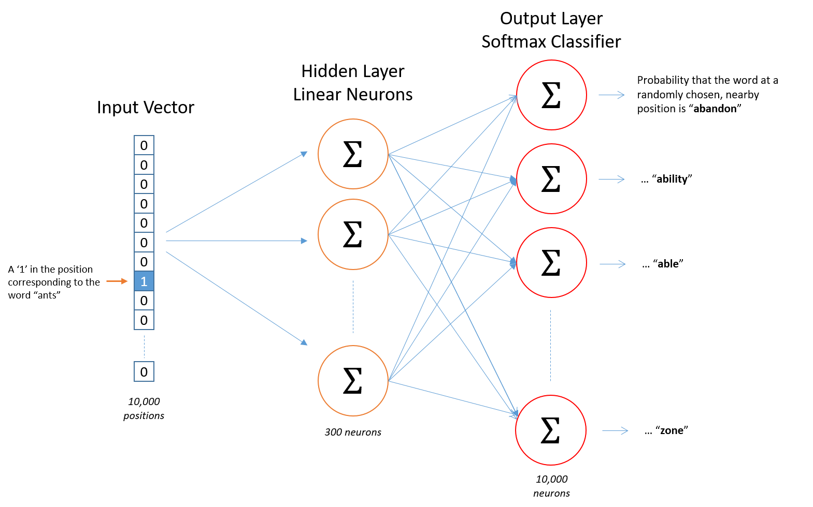
Word2Vec (Skip-gram)
The network learns 300 features for each word.
Sample corpus size is 10,000 words.
Output size and one-hot encoding size matches the corpus size (10,000).

Slide 36
Some other Word Embeddings
GloVe: Improved upon word2vec. It also considers statistical word co-occurance. https://nlp.stanford.edu/projects/glove/
ConceptNet-Numberbatch: Combines data from Word2Vec, GloVe and ConceptNet https://github.com/commonsense/conceptnet-numberbatch
fastText: Considers fixed length sequence of characters (n_gram) instead of words.
For example: “artificial” with n_gram=3 becomes <ar, art, rti, tif, ifi, fic, ici, cia, ial, al>
https://fasttext.cc

Slide 37
Word Vectors - Hands on
In this exercise, we work with Word Vectors from ConceptNet Numberbatch.
The exercise covers the following topics:
Read the word vectors from their source
Understand word similarity
Reduce vectors dimensions and visualize them
Follow through this notebook: “EMBK-NLP-DAY3-WORD-VECS-NB.ipynb”

Slide 38
Topics for Day 3
Neural Networks (NN)
Word Embeddings
Recurrent Neural Networks (RNN)
Long Short-Term Memory (LSTM)
Transformers
Final Project

Slide 39
Recurrent Neural Networks
Recurrent Neural Networks (RNNs) are different from regular neural networks in a few ways:
RNNs can work on varying size inputs-outputs. We have looked at fix size input-output networks so far.
RNNs can model sequential information well. We pass “state” state vectors between RNN units to deal with sequential data.
Text data involves sequential information of words. Therefore, after words are converted to word vectors, we can use them with RNNs.

Slide 40
Sample RNN
y_{t}
y_{t+1}
y_{t+2}
x: Input
h: State
t: Timestamp (order)
y: Output
h_{t-1}
h_{t}
h_{t+1}
h_{t+2}
….
x_{t}
x_{t+1}
x_{t+2}

Slide 41
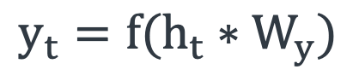
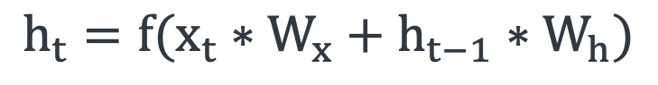
The Vanilla RNN Cell
y_{t}
x: Input
h: State
t: Timestamp (order)
y: Output
W_{x}: Input weight matrix
W_{h}: State weight matrix
W_{y}: Output weight matrix
f: Activation function
W_{y}
h_{t}
h_{t-1}
W_{h}
$$h_{t}=f(x_{t}∗W_{x}+h_{t−1}∗W_{h})$$
$$y_{t}=f(h_{t}∗W_{y})$$
W_{x}
x_{t}

Slide 42
RNN Cells
y_{t}
y_{t+1}
y_{t+2}
Weight sharing: Each unit has the same weights: W_{h}, W_{x}, W_{y}
W_{y}
W_{y}
W_{y}
h_{t}
h_{t+1}
h_{t+2}
h_{t-1}
W_{h}
W_{x}
W_{x}
W_{x}
x_{t}
x_{t+1}
x_{t+2}

Slide 43
Stacking RNNs
We can increase the complexity (capability) of the model by stacking RNNs and increasing the depth of the model.
depth
time

Slide 44
Putting it all together - Hands on
In this exercise, we continue to work with our final project dataset (but predicting a different field, log_votes).
The exercise covers the following topics we learned today:
GloVe Word Vectors
ML Model: Recurrent Neural Network (RNN)
Follow through this notebook: “EMBK-NLP-DAY3-RNN-NB.ipynb”

Slide 45
Topics for Day 3
Neural Networks (NN)
Word Embeddings
Recurrent Neural Networks (RNN)
Long Short-Term Memory (LSTM)
Transformers
Final Project

Slide 46
Long Short-Term Memory (LSTM)
RNNs may have difficulty with long-term dependency in input sequences.
Long Short-Term Memory (LSTM) networks employ different gate structures to solve these problems such as:
Input gate
Forget gate
Output gate
LSTMs also use a memory line that goes through all gates. This acts like the memory of the whole system.

Slide 47
Long Short-Term Memory (LSTM)
h_{t-1}
h_{t}
h_{t+1}
x
+
tanh
x
x
h_{t-1}
σ
σ
σ
tanh
x_{t-1}
x_{t}
x_{t+1}

Slide 48
Long Short-Term Memory (LSTM)
h_{t}
x
+
tanh
x
x
σ
σ
tanh
h_{t-1}
σ
h_{t}
x_{t}

Slide 49
Forget Gate
h_{t}
f_{t}
x
+
tanh
h_{t-1}
σ
(sigmoid)
x
x
σ
σ
h_{t-1}
tanh
σ
h_{t}
x_{t}
x_{t}

Slide 50
Forget Gate
f_{t}
Responsible for removing information from the cell.
x_{t} and h_{t-1} are multiplied by a weight matrix.
Sigmoid is applied to this multiplication.
h_{t-1}
σ
(sigmoid)
x_{t}

Slide 51
Input Gate
h_{t}
x
+
tanh
x
x
x
i_{t}
σ
σ
σ
c_{t}
h_{t-1}
tanh
σ
h_{t}
(sigmoid)
h_{t-1}
tanh
x_{t}
x_{t}

Slide 52
Input Gate
Responsible for adding the new (useful) information to the cell state.
Regulatory filter: x_{t} and h_{t-1} are multiplied by a weight matrix and sigmoid applied (i_{t}).
Tanh filter (-1 to 1 mapping): x_{t} and h_{t-1} are multiplied by a weight matrix and tanh applied (c_{t}).
x
i_{t}
c_{t}
(sigmoid)
σ
tanh
h_{t-1}
x_{t}

Slide 53
Output Gate
h_{t}
x
+
tanh
x
tanh
x
σ
σ
x
h_{t-1}
tanh
σ
h_{t}
σ
h_{t-1}
h_{t}
x_{t}
x_{t}

Slide 54
Output Gate
Selecting suitable output data
Tanh filter (-1 to 1 mapping): applied to cell state.
Regulatory filter(σ): x_{t} and h_{t-1} are multiplied by a weight matrix and sigmoid applied (o_{t}).
Multiply this two values and get h_{t}: output of this cell and hidden state of next cell.
Cell state
tanh
o_{t}
x
σ
h_{t-1}
h_{t}
x_{t}

Slide 55
Topics for Day 3
Neural Networks (NN)
Word Embeddings
Recurrent Neural Networks (RNN)
Long Short-Term Memory (LSTM)
Transformers
Final Project

Slide 56
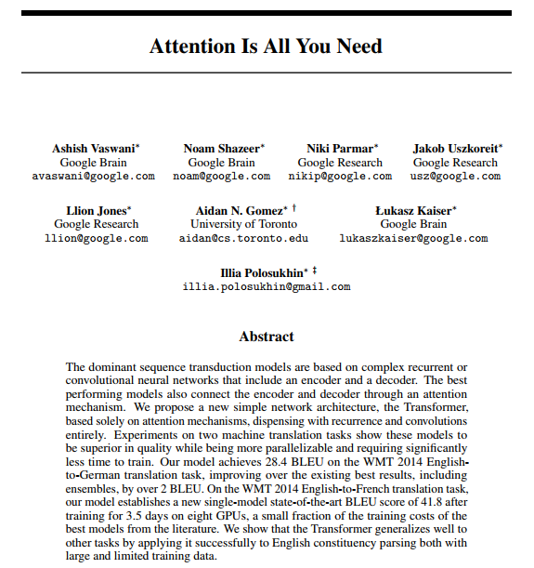
What are Transformers
Transformers are a type of neural network architecture that builds high level representations of text directly allowing for long range correlations, rather than building it sequentially.
A series of landmark papers starting with “Attention is all you need” have established it as the state-of-the-art technique for most NLP tasks.

Slide 57
An Alternate View
Recurrent Neural networks process one token at a time
In linguistics, people believe that instead sentences are best understood by combining into higher level concepts
Can we make a model that mirrors this philosophy?
I
kicked
the
ball
S
VP
S: Sentence
VP: Verb Phrase
NP: Noun Phrase
NP
NP
I
kicked
the
ball

Slide 58
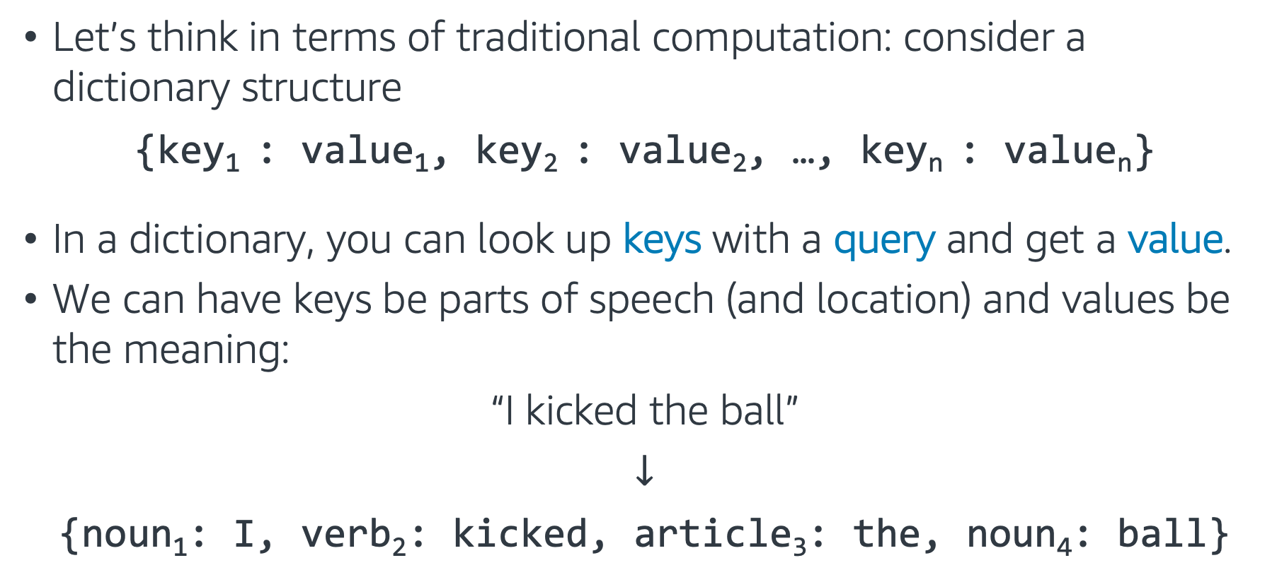
Traditional Programming Intuition 1
Let’s think in terms of traditional computation: consider a dictionary structure
{key₁ : value₁, key₂ : value₂, …, key_{n} : value_{n}}
In a dictionary, you can look up keys with a query and get a value.
We can have keys be parts of speech (and location) and values be the meaning:
“I kicked the ball”
$↓$
{noun₁: I, verb₂: kicked, article₃: the, noun₄: ball}

Slide 59
Traditional Programming Intuition 2
To build trees like we saw, each token can query for other nearby tokens that match a target:
Each noun queries for a nearby verb to be the subject or object of
Articles query for nearby nouns
Verbs query for objects
and so on…
{noun₁: I, verb₂: kicked, article₃: the, noun₄: ball}
Verb?
Noun?
Noun?
Verb?

Slide 60
Traditional Programming Intuition 3
These can then be combined into higher level objects.
This can be iterated until the entire sentence merges.
{NP₁: I kicked, VP₂: kicked ball, NP₃: the ball, VP₄: kicked ball}
{noun₁: I, verb₂: kicked, article₃: the, noun₄: ball}

Slide 61
What does this require?
For this process to work we needed a few components:
A key describing what questions each word responded to
A value describing what information that word contains when it answers a question
A query describing what every word was looking to combine with
Then the values were combined for those keys that matched the queries, and the process repeated.

Slide 62
How to Build as a Neural Network
As common in neural architectures, the key, query, and value will all be represented by vectors of numbers.
Query
Word & Position
Average
Vector
Key
Softmax
Vector
Value
Query
Word & Position
Average
Vector
Key
Softmax
Vector
Value

Slide 63
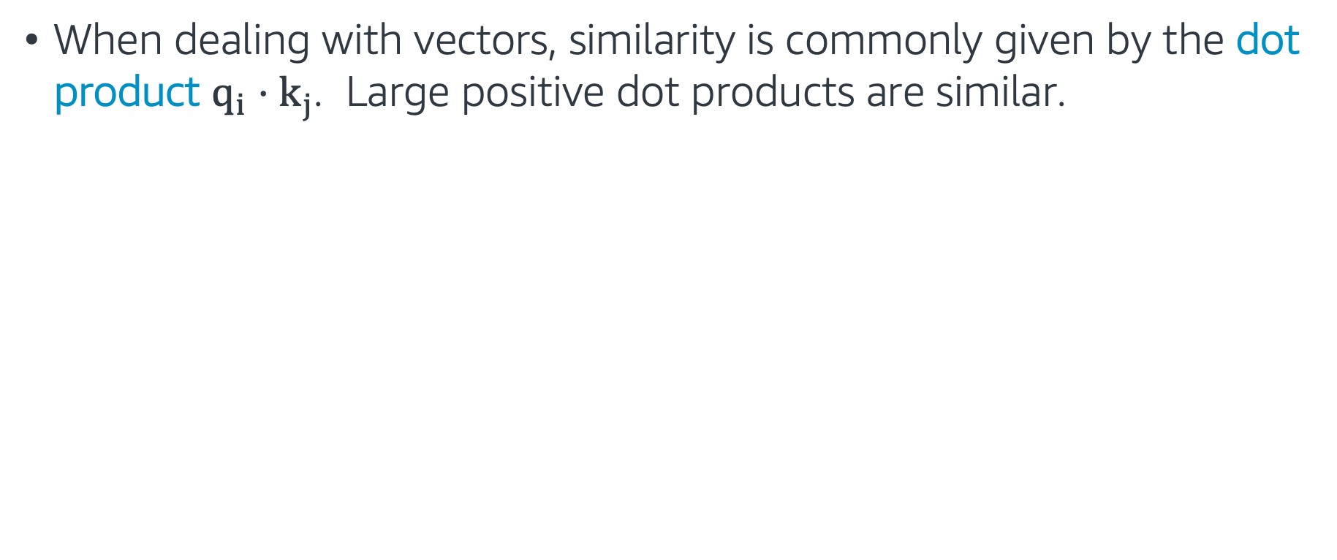
How to Build as a Neural Network
When dealing with vectors, similarity is commonly given by the dot product $q_{i}⋅k_{j}$. Large positive dot products are similar.
Dot products
Query
Word & Position
Average
Vector
Key
Softmax
Vector
Value
Query
Word & Position
Average
Vector
Key
Softmax
Vector
Value

Slide 64
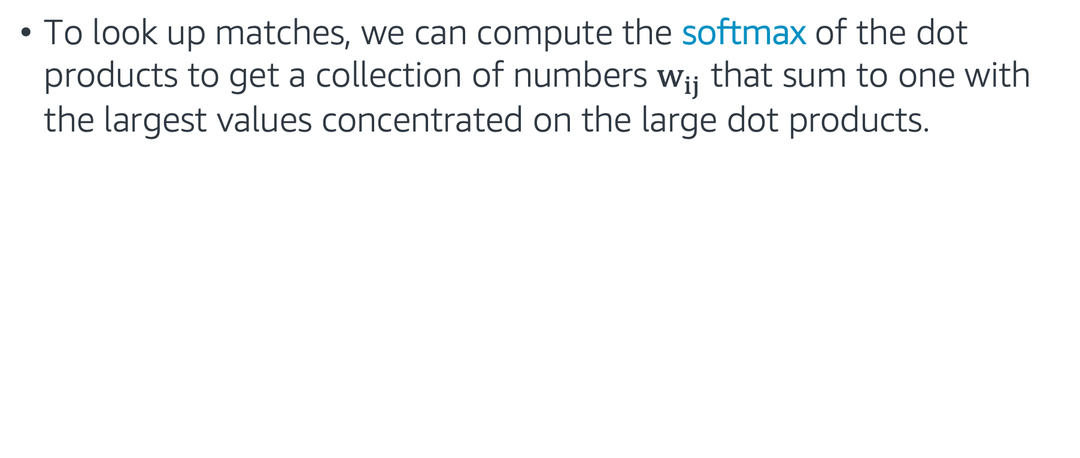
How to Build as a Neural Network
To look up matches, we can compute the softmax of the dot products to get a collection of numbers $w_{ij}$ that sum to one with the largest values concentrated on the large dot products.
Dot products
Query
Word & Position
Average
Vector
Key
Softmax
Vector
Value
Query
Word & Position
Average
Vector
Key
Softmax
Vector
Value

Slide 65
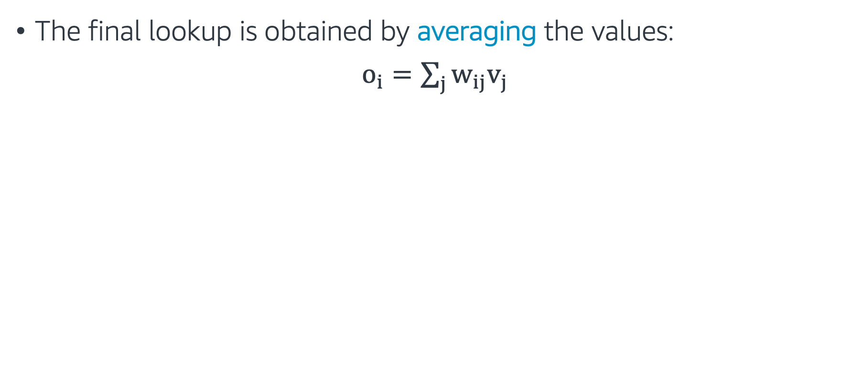
How to Build as a Neural Network
The final lookup is obtained by averaging the values:
$o_{i}=\sum_{j}{w_{ij}v_{j}}$
Dot products
Query
Word & Position
Average
Vector
Key
Softmax
Vector
Value
Query
Word & Position
Average
Vector
Key
Softmax
Vector
Value

Slide 66
How to Build as a Neural Network
This process is repeated for every location in the network.
Dot products
Query
Word & Position
Average
Vector
Key
Softmax
Vector
Value
Query
Word & Position
Average
Vector
Key
Softmax
Vector
Value

Slide 67
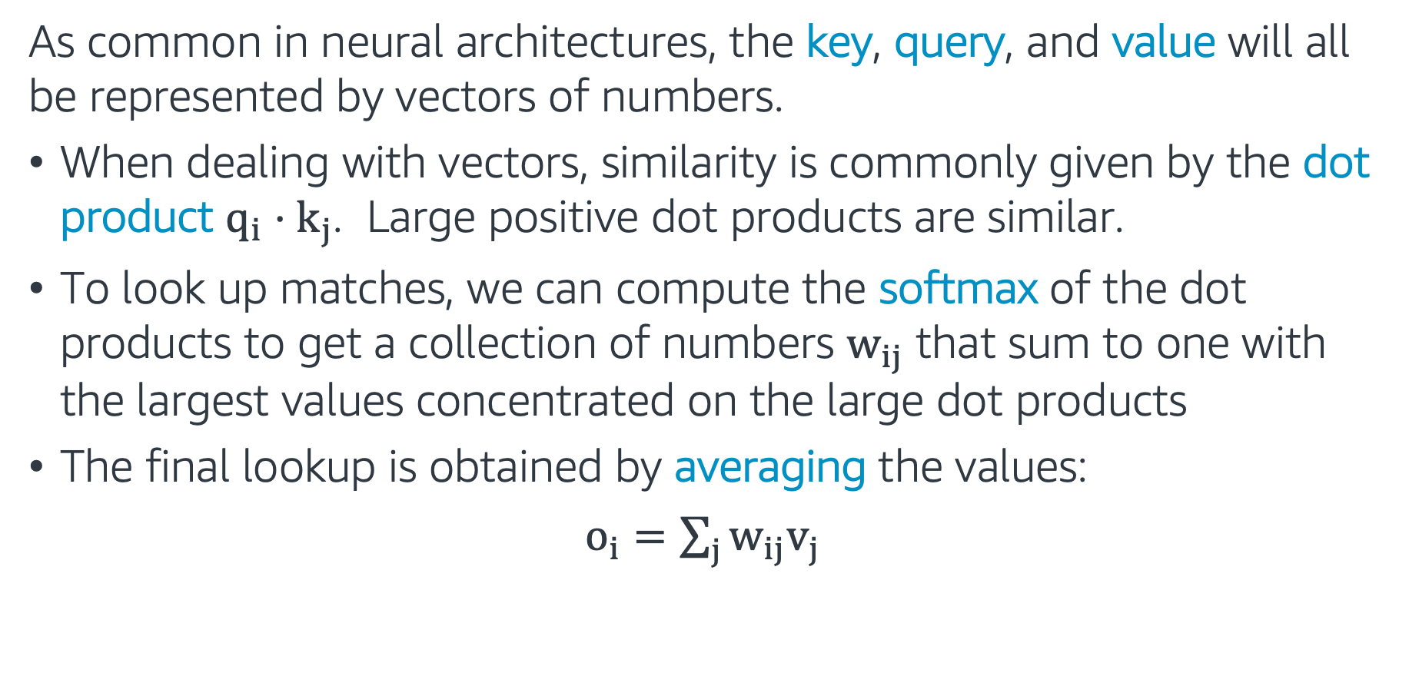
In summary
As common in neural architectures, the key, query, and value will all be represented by vectors of numbers.
When dealing with vectors, similarity is commonly given by the dot product $q_{i}⋅k_{j}$. Large positive dot products are similar.
To look up matches, we can compute the softmax of the dot products to get a collection of numbers $w_{ij}$ that sum to one with the largest values concentrated on the large dot products
The final lookup is obtained by averaging the values:
$o_{i}=\sum_{j}{w_{ij}v_{j}}$

Slide 68
Attention
Attention is a mechanism that forces the model to learn to focus (to attend) on specific parts of the input sequence.
Self-Attention is a mechanism where every token in the data attends to all other tokens in the input sequence.

Slide 69
An issue: Polysemy
Consider some of the meanings of the word ”tie”
How do we adapt our model to allow for this ambiguity?
verb: to fasten or attach
“I tied the bag closed.”
verb: to establish in relationship
“We tied the criminal to the scene of the crime.”
noun: railway supports
“She hammered the rail to the tie.”
noun: sustained tone in music:
“The tie holds the note into the next measure.”
noun: equality in a contest
“The game ended in a tie.”
noun: Something knotted when worn
“He put on his favorite tie for the job interview”

Slide 70
Multi-headed Attention
To solve this issue, every token (and every subsequent layer) will emit multiple keys, multiple values, and multiple queries! This is called multi-headed attention.
Query
Word & Position
Query
Query
Softmax
Average
Vector
Key
Softmax
Average
Key
Softmax
Average
Vector
Key
Value
Value
Value
Query
Word & Position
Query
Query
Softmax
Average
Vector
Key
Softmax
Average
Key
Softmax
Average
Vector
Key
Value
Value
Value

Slide 71
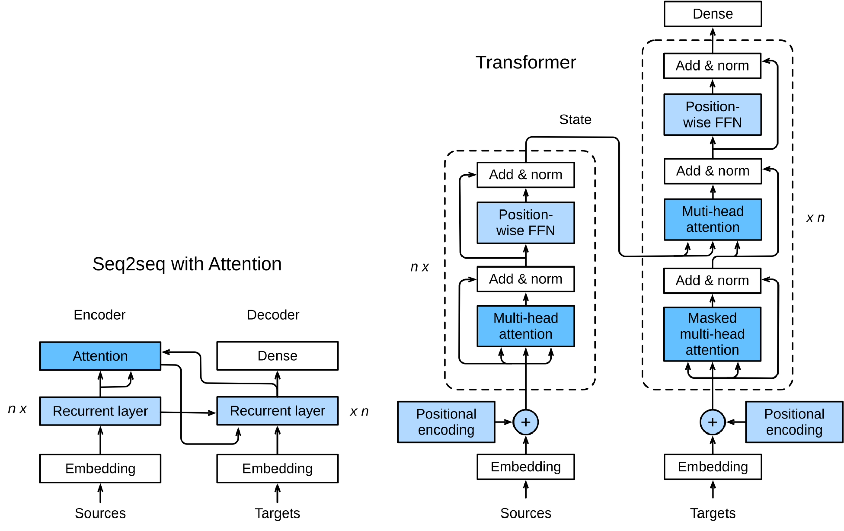

Transformers
The full transformer architecture is made by combining many layers of this type, often times into an encoder-decoder pair which turns words into vectors then vectors back to words.
Full details are available at d2l.ai.

Slide 72
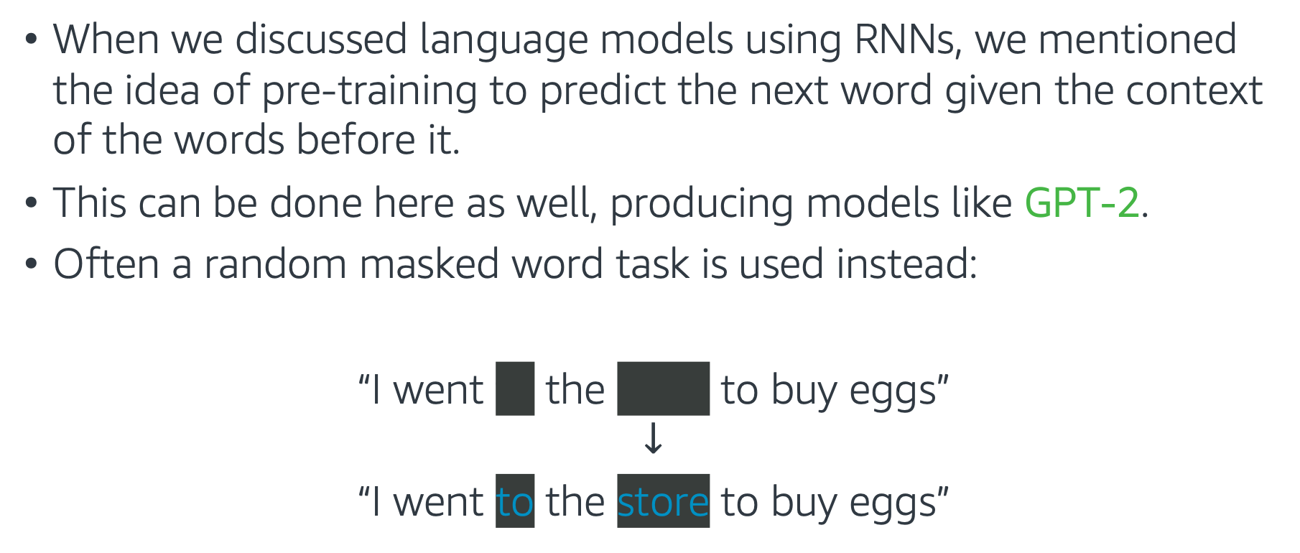
Typical Objectives
When we discussed language models using RNNs, we mentioned the idea of pre-training to predict the next word given the context of the words before it.
This can be done here as well, producing models like GPT-2.
Often a random masked word task is used instead:
“I went to the store to buy eggs”
$$↓$$
“I went to the store to buy eggs”

Slide 73
Pre-trained Models
These models tend to be very large, and can take weeks to train on the most expensive instances. Thus, is common to pre-train a model on a large corpus of text, and use it for downstream tasks.
The Gluon NLP Model Zoo contains a large number of pretrained transformers (in this case versions of BERT, one of the original largescale transformers).

Slide 74
Utilizing Pre-trained Models
There are multiple ways to use these pre-trained models:
Use it as a fixed encoder (no training cost). We investigate this in a notebook example.
The model can be fine-tuned end-to-end as a classifier.
The model can be fine-tuned as a language model on your specific dataset, then used as an encoder or fine-tuned on the classification task.
The model can be trained from scratch. This is very intensive, and should only be done with 50GB+ of text.
INCREASING COST

Slide 75
Transformers - Hands on
In this exercise, we work with BERT from Gluon NLP Model Zoo
The exercise covers the following topics:
Installing Gluon NLP
Using a pretrained BERT model to encode a sentence
Follow through this notebook: “EMBK-NLP-DAY3-BERT-NB.ipynb”

Slide 76
Topics for Day 3
Neural Networks (NN)
Word Embeddings
Recurrent Neural Networks (RNN)
Long Short-Term Memory (LSTM)
Transformers
Final Project

Slide 77

Final Project – Sentiment Analysis
Data: Customer reviews. Let's look at first 5 rows of the training dataset:
Task: Train a classifier to predict the isPositive field for the test dataset.
Follow through this notebook ”EMBK-NLP-DAY3-FINAL-STUDENT-NB.ipynb” to start on the final project.

Slide 78
Notebooks for Day 3
EMBK-NLP-DAY3-NN-NB.ipynb: Build Neural Networks with Gluon
EMBK-NLP-DAY3-WORD-VECS-NB.ipynb: Word Vectors
EMBK-NLP-DAY3-RNN-NB.ipynb: Training Recurrent Neural Networks
EMBK-NLP-DAY3-BERT-NB.ipynb: Gluon NLP and BERT
EMBK-NLP-DAY3-FINAL-STUDENT-NB.ipynb: Final Project Walkthrough for Day 3
EMBK-NLP-DAY3-FINAL-SOLUTION-NB.ipynb: Final Project Solution for Day 3

Slide 79
Looking Ahead - Day 4
AutoML
Computer Vision Applications
Images and Filtering
Convolutional Neural Networks (CNN)
Transfer Learning

